Slide 1
A FRAMEWORK TO EVALUATE MARINE RESERVES IN MEXICO
Caio Faro, Jael Martinez, Juan Carlos Villasenor and Melaina Wright
TURFeffect
Fall Review Meeting
November 03, 2016

Slide 2
Objectives

Slide 3
Summer and Fall Progress
Data Collection
Indicators and Reserves Objectives
Survey
Data Analysis
Outreach and Feedback

Slide 4
Summer and Fall Progress Data Collection
Juan Carlos over the summer
Jael and the ETJ
CPI

Slide 5
Summer and Fall Progress Indicators and Reserves’ Objectives

Slide 6
Summer and Fall Progress Survey
Application over the summer
Review and Improvement
New tests in 1 week

Slide 7
Summer and Fall Progress Data Analysis
Improved analysis and changed methods

Slide 8
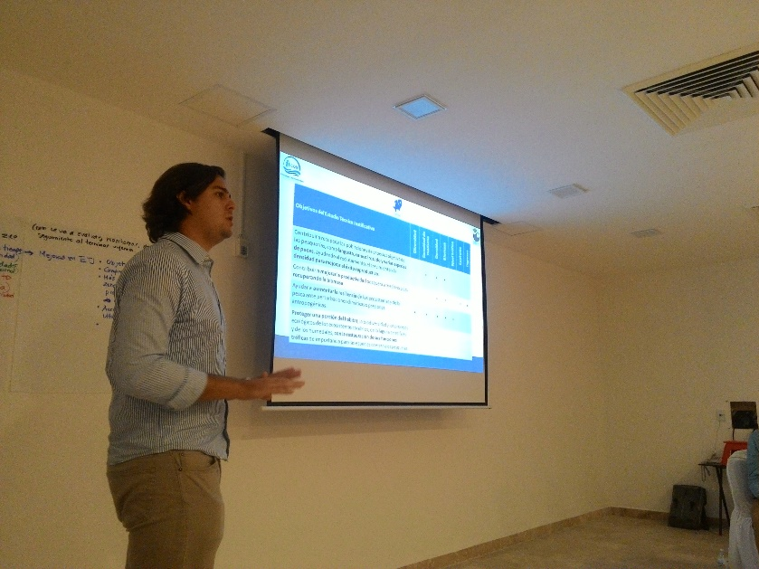
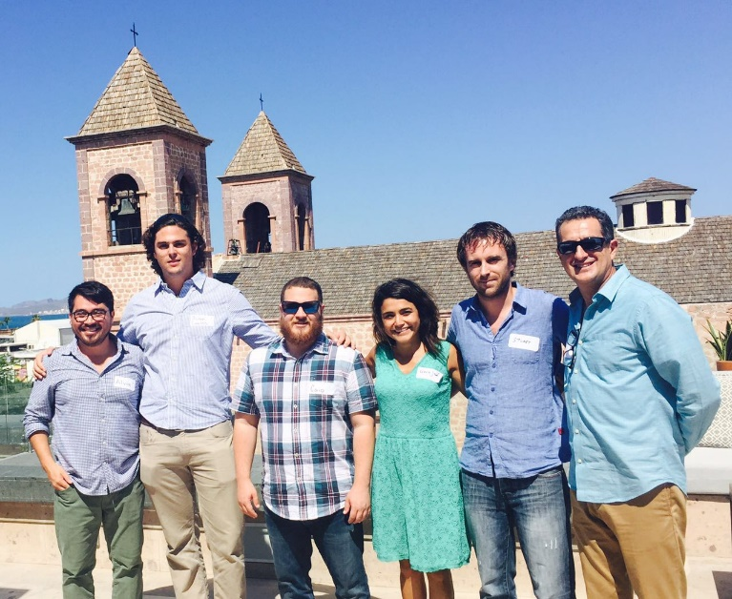
Summer and Fall Progress Outreach and Feedback
Workshop “ Evaluacion y Seguimiento de Zonas de Refugio en Mexico” – La Paz, Mexico.
Presentation of list of indicators and preliminary results from Quintana Roo.
Group activity to debate possible indicators in the evaluation of fishing refugees.

Slide 9
Next Steps
Field trip to Mexico
Guidebook outline
Shiny app (beta version)
Final Report outline

Slide 10
Thank you!

